Slide 1
Creating a Clean, Unbreakable Grid
Energy Policy Roundtable
Kleinman Center, Philadelphia
Kiran Kumaraswamy
Market Development Director
22 February 2017
Notes:
Changed title

Slide 2
About the AES Corporation
Mission: Improving lives by providing safe, reliable and sustainable energy solutions in every market we serve.
AES Serves
10M
CUSTOMERS
6
4
17
MARKET-FACING
STRATEGIC BUSINESS UNITS
CONTINENTS
8
UTILITY
COMPANIES
COUNTRIES
$37B
TOTAL ASSETS
OWNED & MANAGED
$15B
TOTAL 2015
REVENUES
36,000 MW
GENERATION CAPACITY
21,000
GLOBAL
WORKFORCE

Slide 3

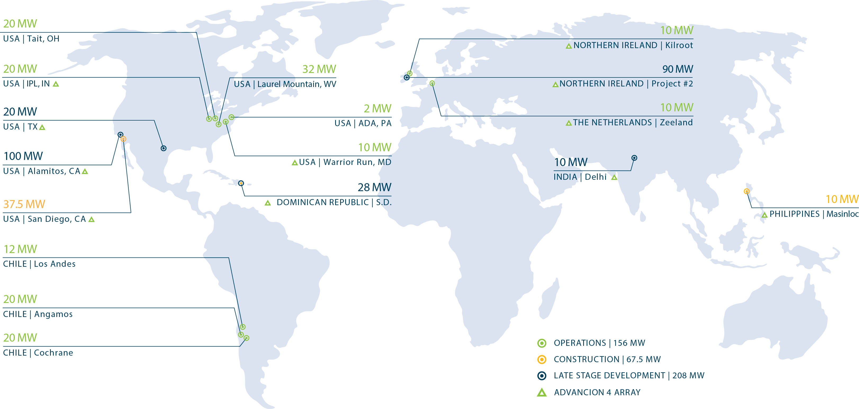
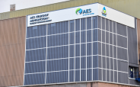


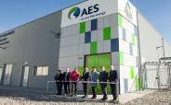
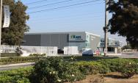
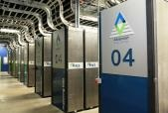


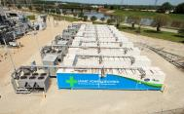
AES is the global leader in utility-scale energy storage.

Slide 4
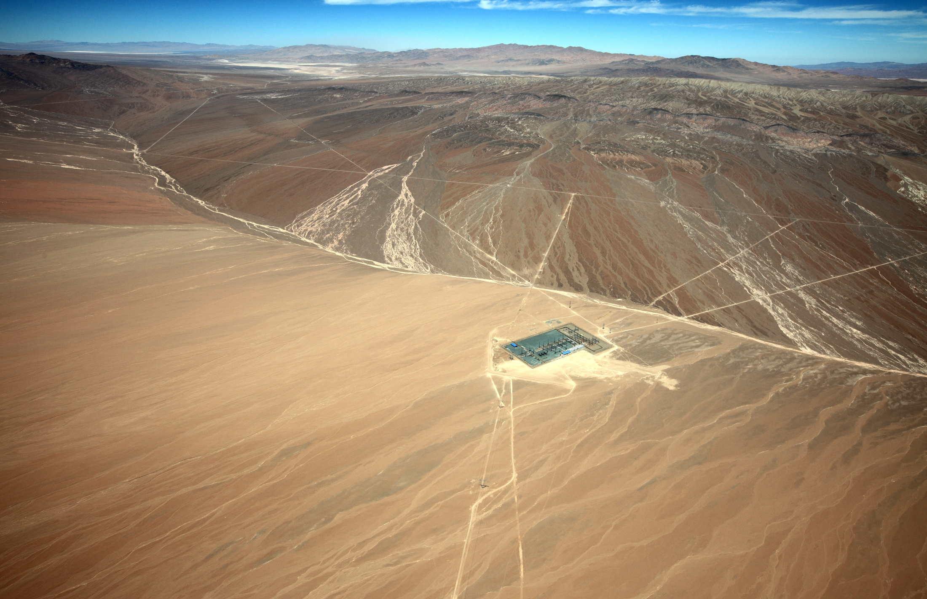
First Wave: Energy storage supplying critical spinning reserves.
12 MW Los Andes
Atacama, Chile

Slide 5
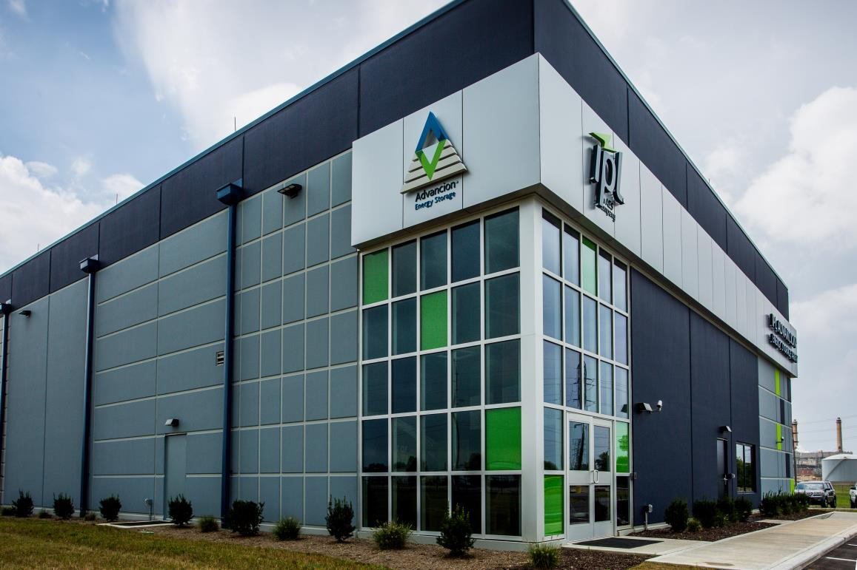
Second Wave: IPL facility built in under 12 months from ground breaking to commissioning
How fast is fast?
LOCATION
Indianapolis, IN
THE APPLICATION
Grid and transmission reliability
A city with the second highest solar energy production per capita in the US
Energy storage allows infrastructure to be more appropriately sized and get higher utilization out of the assets we already have.

Slide 6
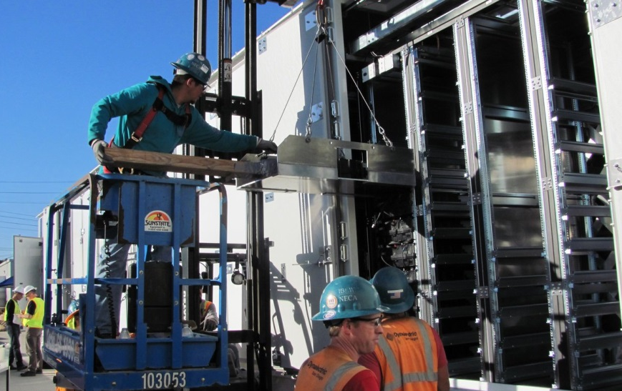
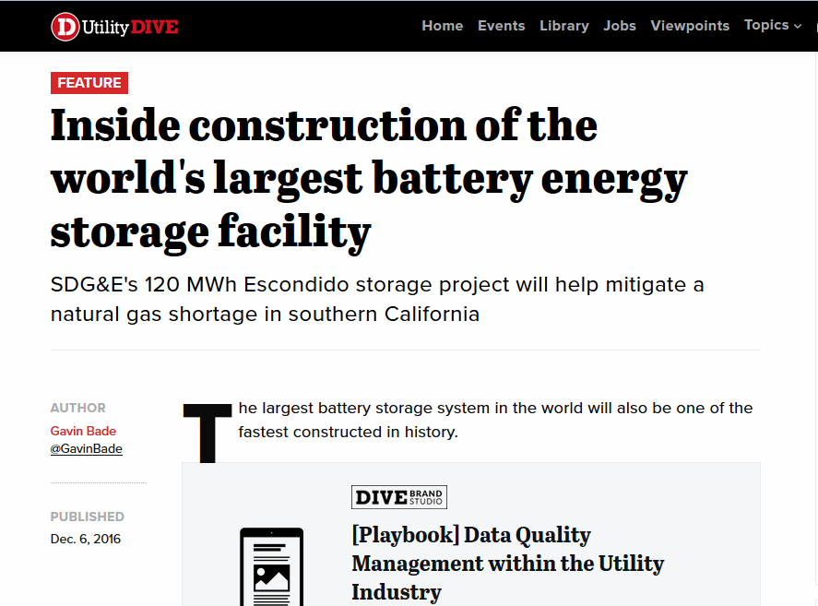
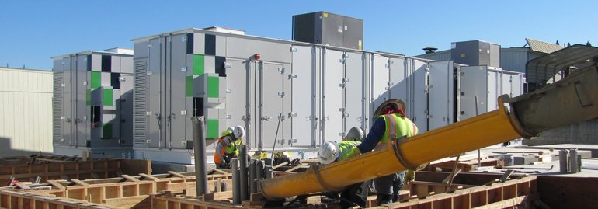
Third Wave: San Diego Gas and Electric procures 37.5MW in record time
Meeting peak energy needs in southern California
LOCATION
San Diego, California
THE NEED
Reliable and affordable energy to meet peak demand
Credit: Utility Dive
In southern California where resources are needed to meet local peak capacity needs
Deliver energy storage for peak capacity applications in 6 months.

Slide 7
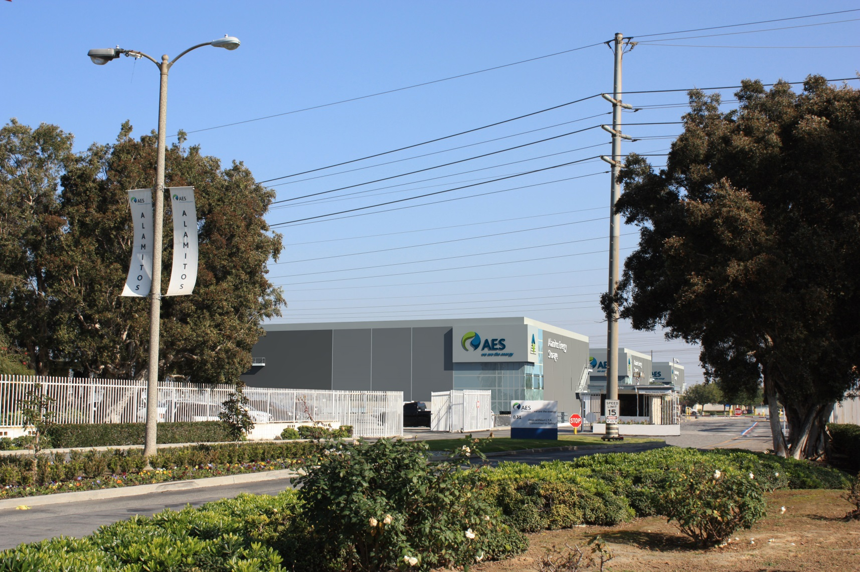
Near Future: Alamitos meeting southern California energy needs as infrastructure retires
Delivery 100 MW of peak power for 20 years
LOCATION
Long Beach, California
THE NEED
Environmentally responsible and highly flexible resources in preferred locations
In the densely populated Los Angeles basin with limited site, modernizing existing generation sites is critical.
California's environmental objectives and rapidly changing net load profile require clean, fast ramping peak power solutions to reduce emissions and improve utilization of renewable energy.

Slide 8
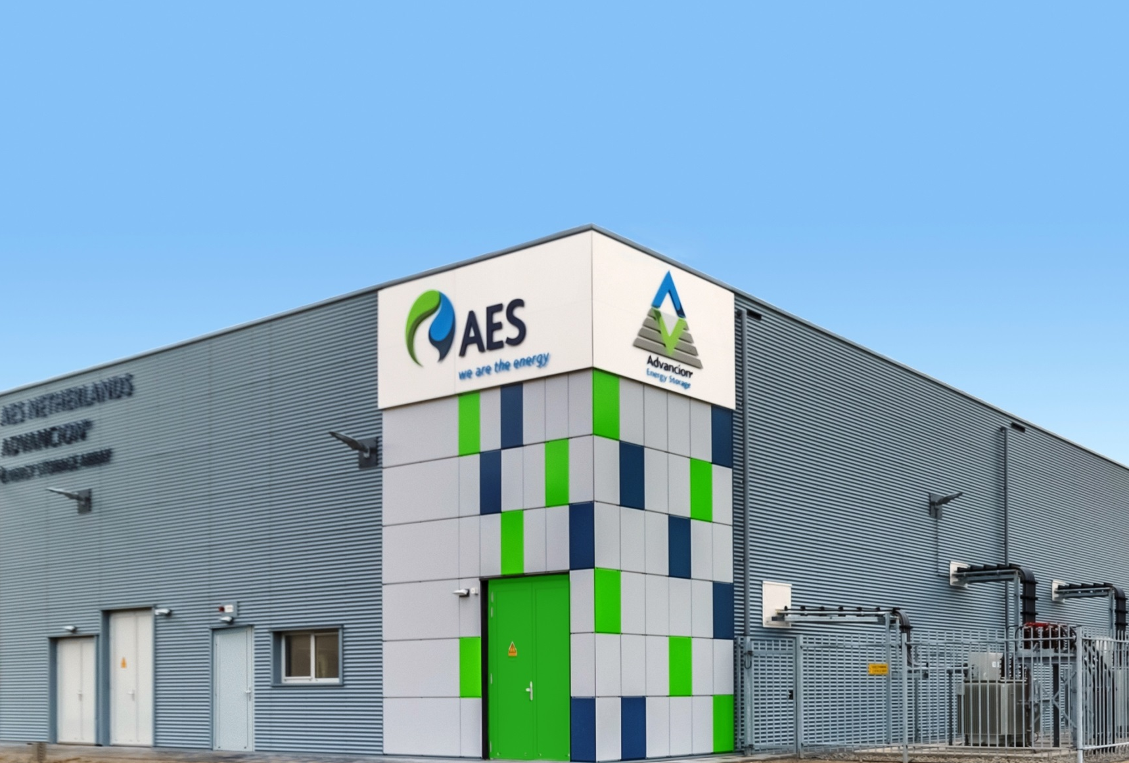
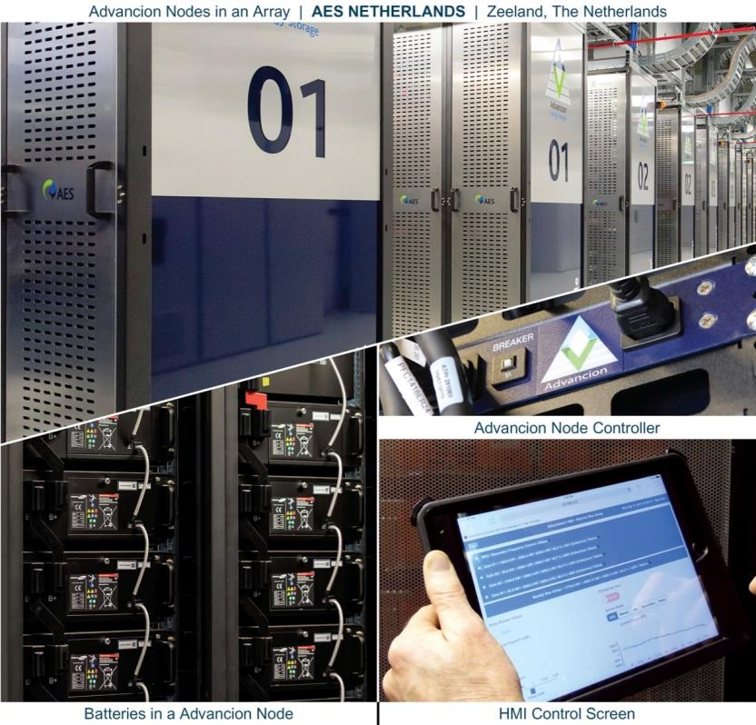
Advancion® is a complete solution for clean flexible power combined with full turn-key delivery
AES PRIOPRIETARY AND CONFIDENTIAL
Available around the globe for owners and operators of Energy Storage assets
KEY DIFFERENTIATORS
Nodal architecture
Proprietary and patented controls
Supply chain and Advancion® Certification Program
AES operational experience

Slide 9
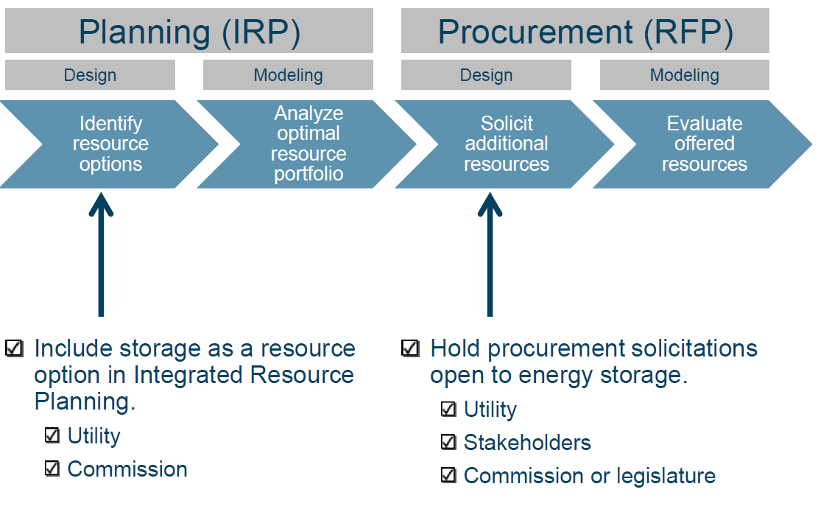
How can states and utilities incorporate energy storage in resource planning and procurement?
Include all benefits of storage in modeling and evaluation

Slide 10



10
Thanks!
Kiran Kumaraswamy
571.527.8498
Kiran.Kumaraswamy@aes.com

